Slide 1
WEB SITE PROJECT
Groupe 6
SUPERVISOR: Mr. Ghislain TSEFFO

Slide 2

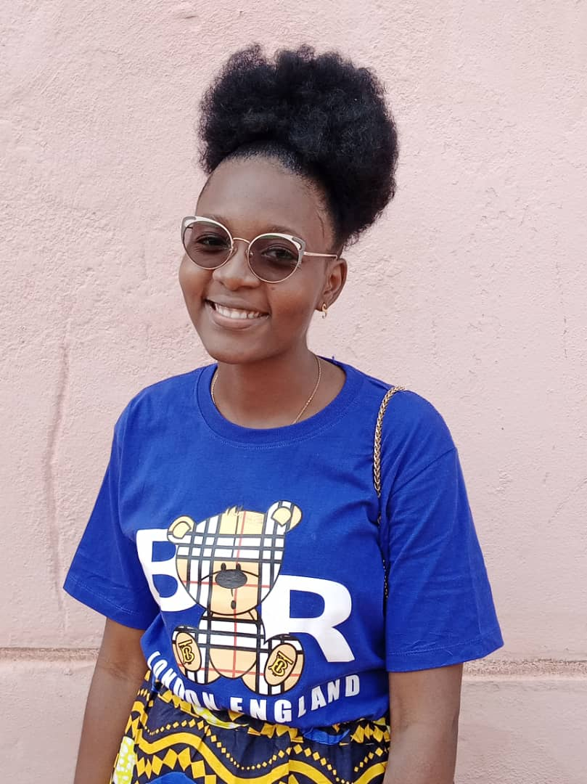
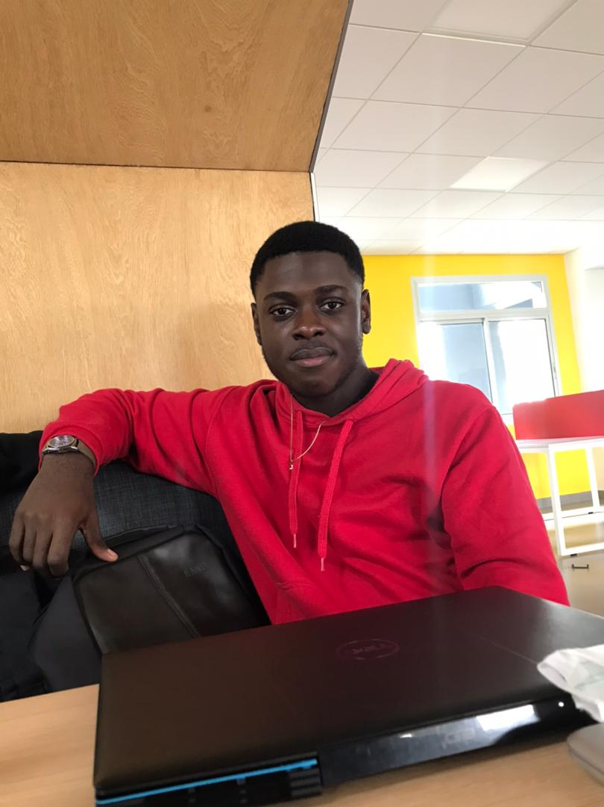
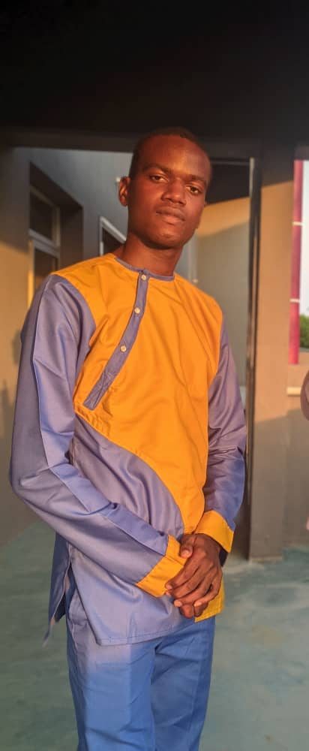
OUR TEAM
CHABAIN NGAMO
JORDAN TCHOUNGA
MAIVA ZEUFACK
ALBERT KANAA
LEADER

Slide 3
Table of contents
01
INTRODUCTION
04
REALIZATION
02
RESOURCES
05
DEMO
03
CONCEPTION
06
CONCLUSION
here we will briefly list the context, the problem posed and our objectives
Here we will explain to you how we make the website
Here we will list all the ressources we used to do the projext
Here we will show you how our website is working
here we will show you the steps of the design of our website
Then we can conclude

Slide 4
INTRODUCTION
CONTEXT
Our BDE wants a website at the height of a computer engineering school in order to manage mainly the promotion of events and an online sales shop. The people who will have a role will of course be the members of the BDE but also the students and some employees of the CESI. We need to facilitate the organization and communication of events within the school, and to offer members goodies with the effigy of the BDE.

Slide 5
Problematic and objectives
Problematic
Objectives
?
How to implement the website and respect all the constraints imposed?
model our site in satique with html
manage our work with laravel well

Slide 6









Ressources

Slide 7
03.
COnception
Let us present to you all about it

Slide 8
Template
Username
nav
For login/out
To display our menu
Header
footer
For more informations and our legal mentions

Slide 9
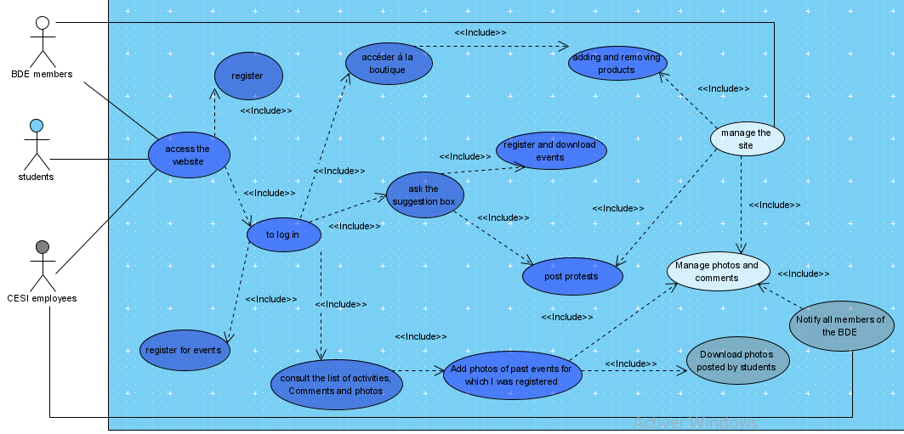
DIAGRAMS
Use case

Slide 10
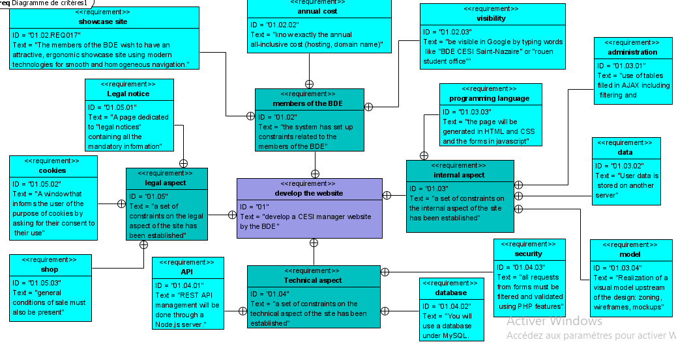
DIAGRAMS
requirements

Slide 11
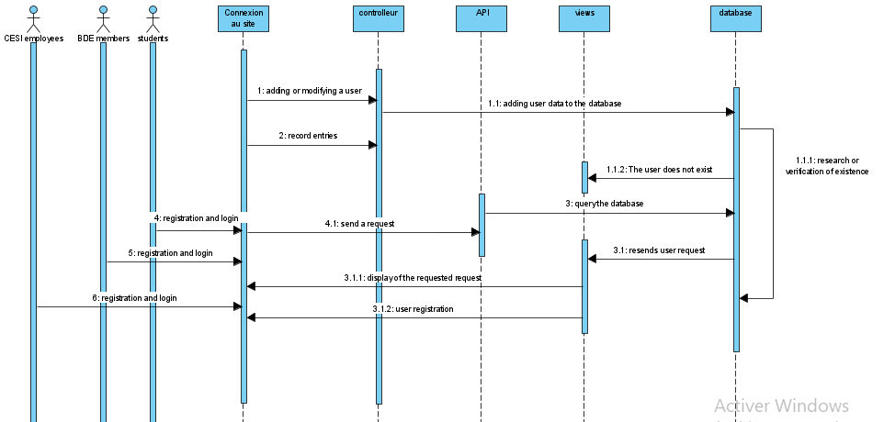
DIAGRAMS
Sequences

Slide 12
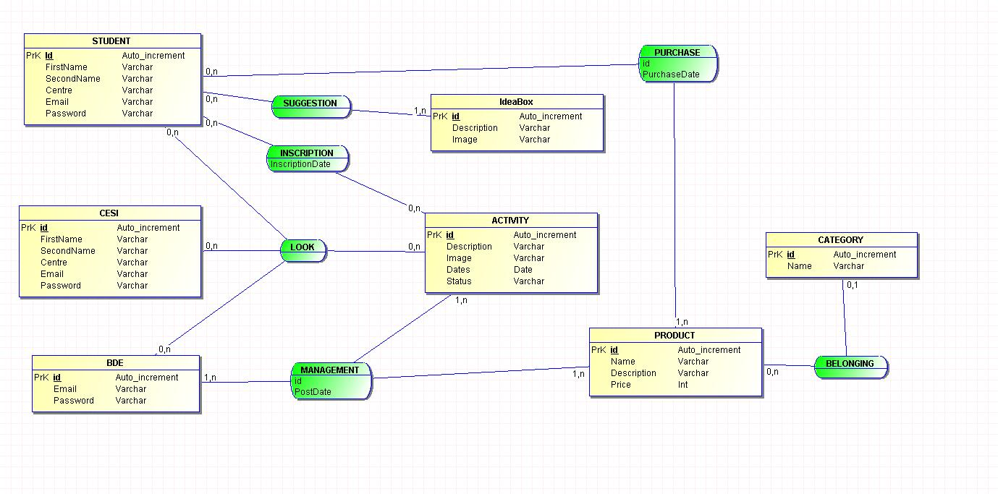
MCD

Slide 13
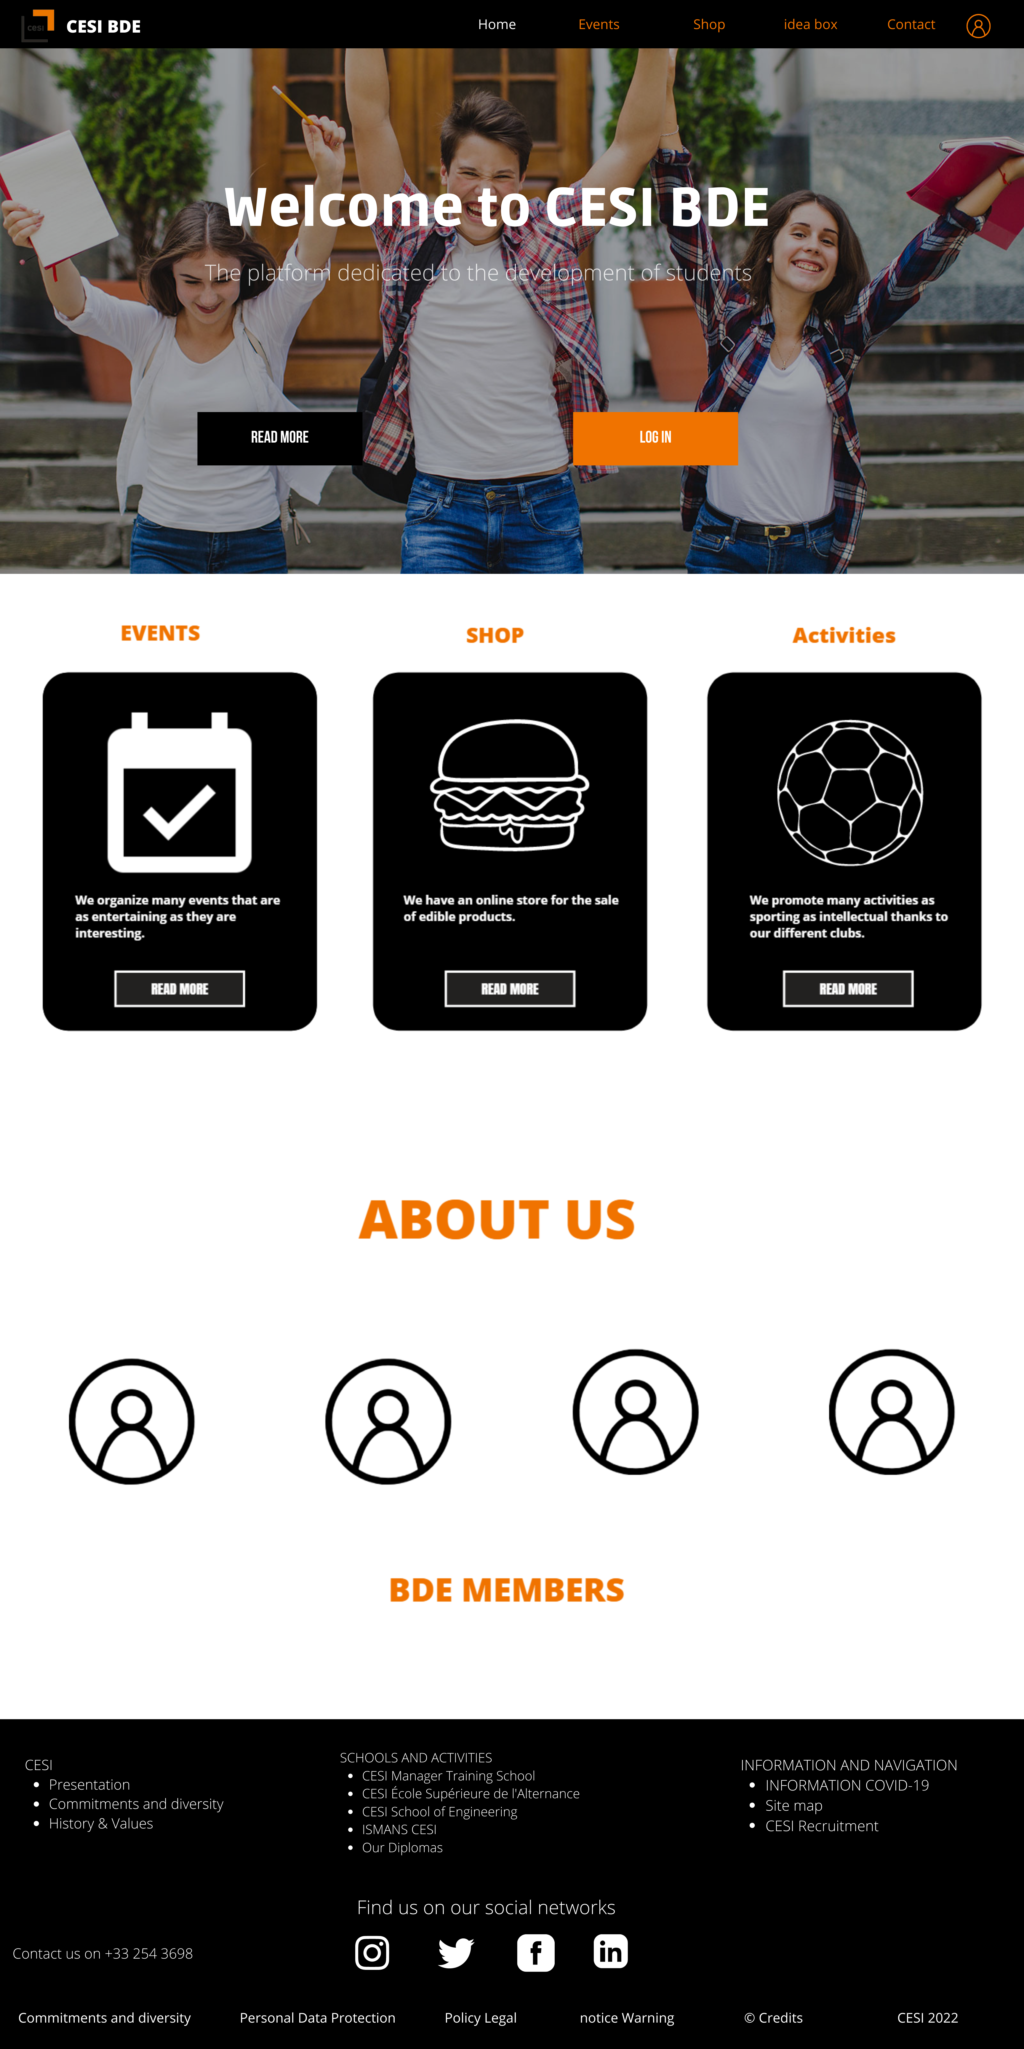
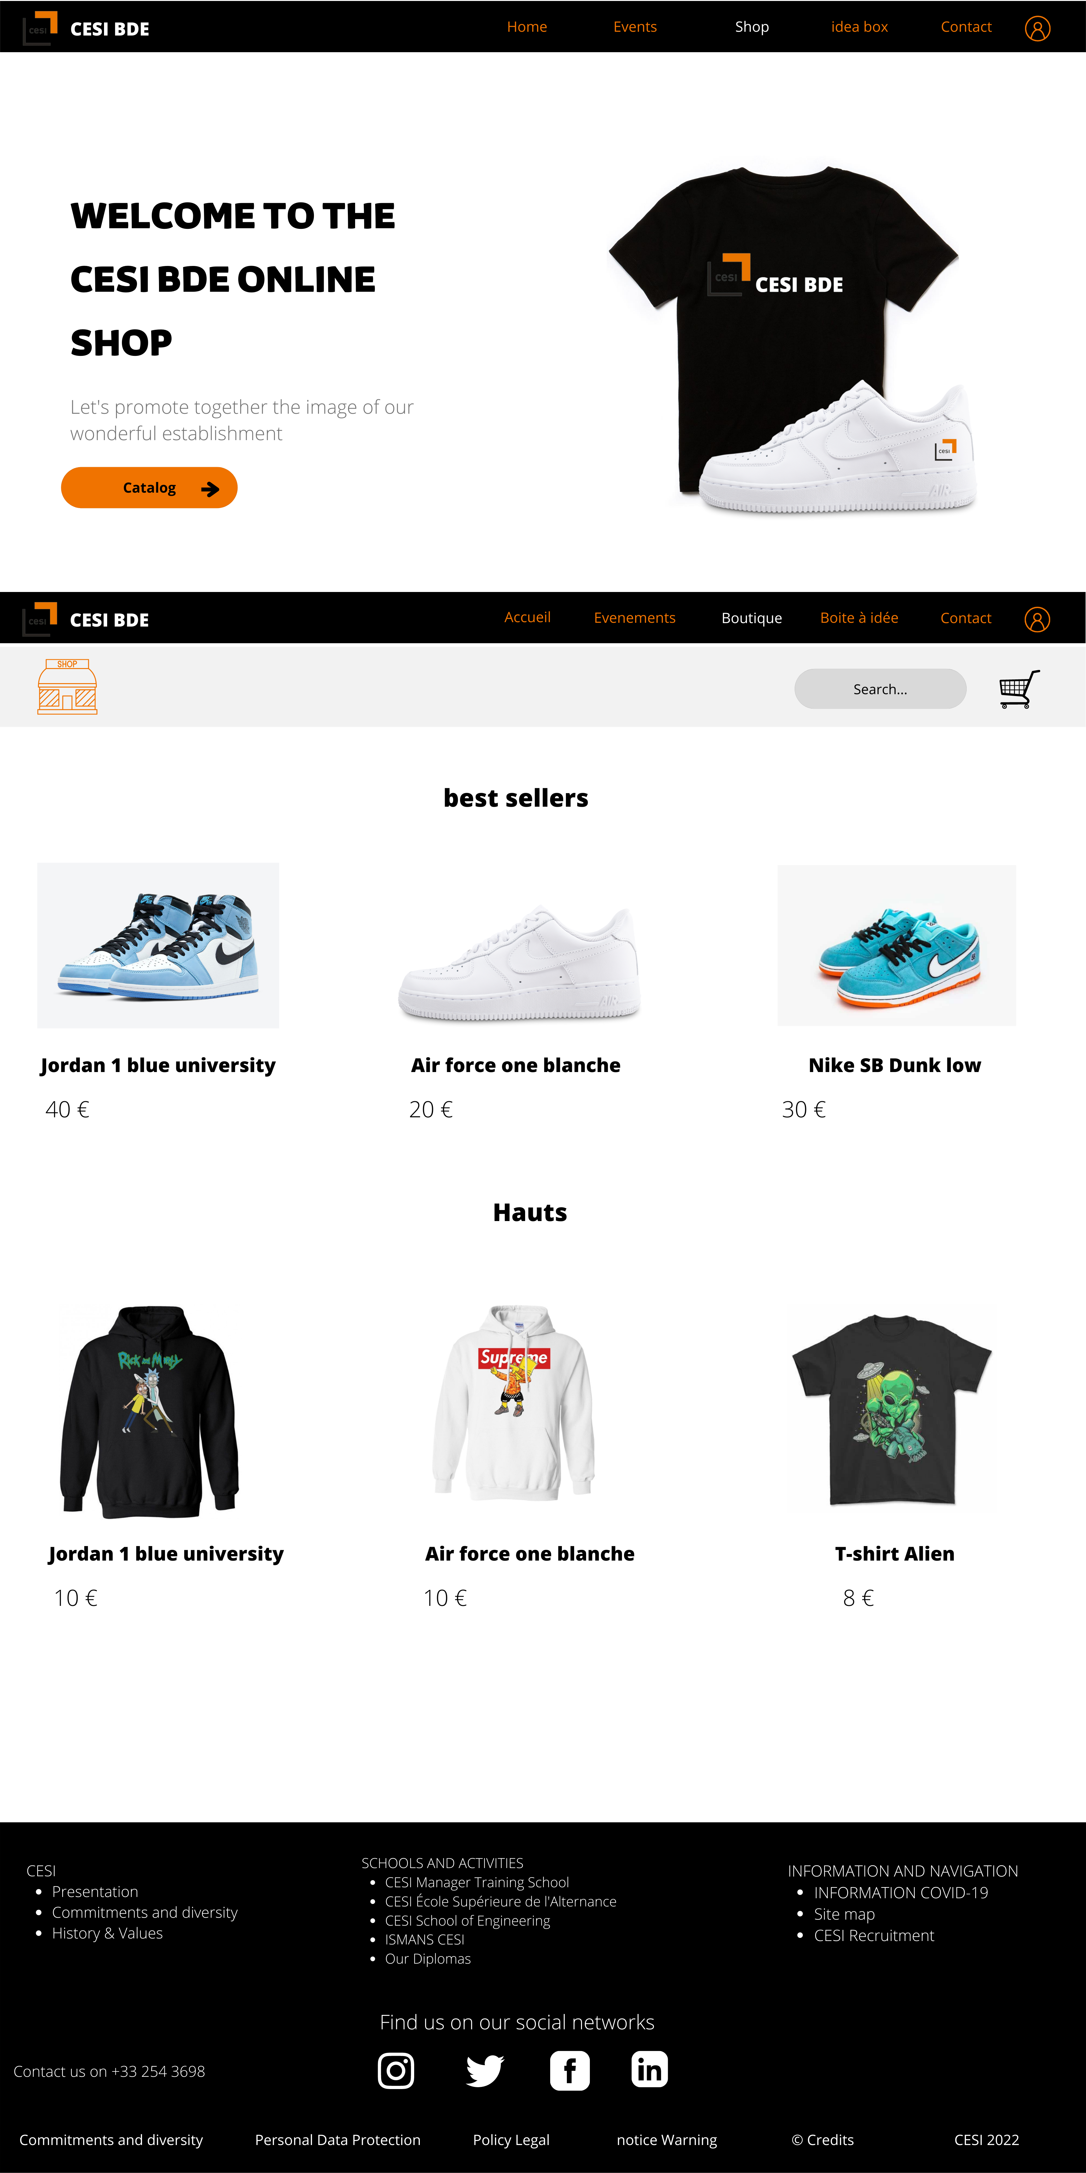
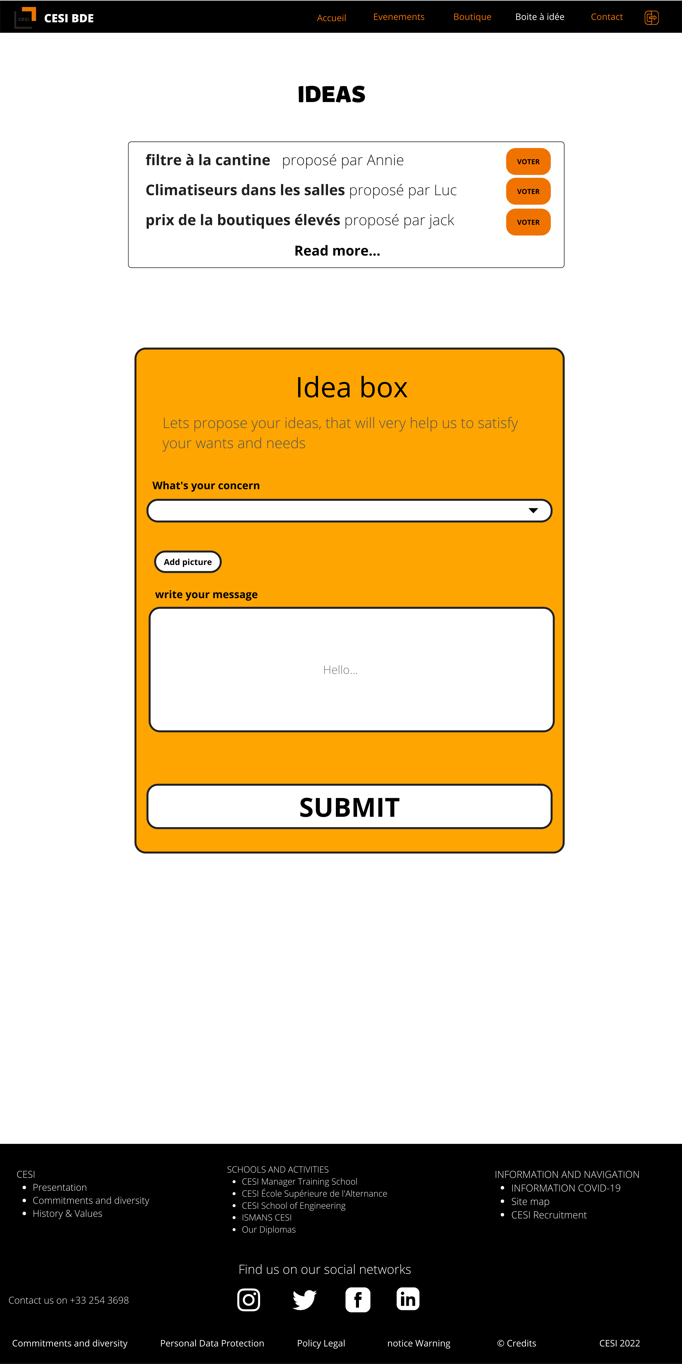
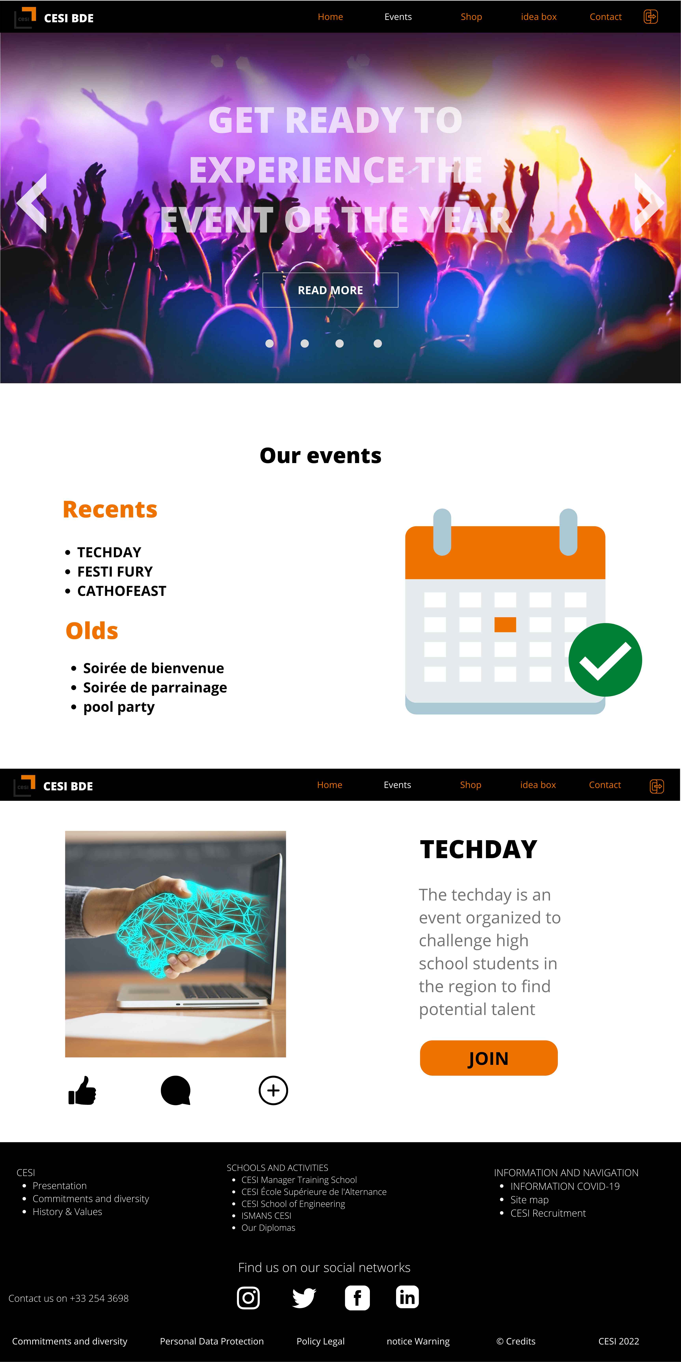
MOOK UP

Slide 14
04.
REALIZATION
Let us present to you all about it

Slide 15
Web company
Do you know what helps you make your point clear? Lists like this one:
They’re simple
You can organize your ideas clearly
You’ll never forget to buy milk!
And the most important thing: the audience won’t miss the point of your presentation

Slide 16
Future projects
Mercury
Venus
Mars
Jupiter
Saturn
Neptune
It’s the closest planet to the Sun
It has extremely high temperatures
Mars is actually a very cold place
Jupiter is the biggest planet of them all
It’s composed of hydrogen and helium
It’s the farthest planet from the Sun

Slide 17
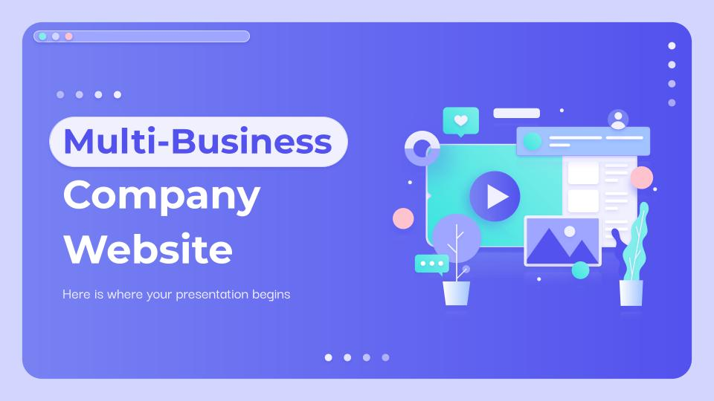
DEMO
IT IS TIME TO SHOW YOU OUR WEBSITE

Slide 18
150,000
Big numbers catch your audience’s attention

Slide 19
24h 37m 23s
333,000,000
386,000 km
Is Jupiter's rotation period
Earths fit in the Sun’s mass
Is the distance between the Earth and the Moon

Slide 20
02.
Company website
You can enter a subtitle here if you need it

Slide 21
Our numbers
15k
25k
60k
Saturn is a gas giant and has several rings
Despite being red, Mars is a cold place
Neptune is the farthest planet from the Sun

Slide 22
Web development
Interface
Functional
Hybrid
Structure
JAVA
PHP
Venus is the second planet from the Sun
It’s the biggest planet in the Solar System
Despite being red, Mars is a cold place
C++
HTML
Saturn is a gas giant and has several rings

Slide 23

A picture always reinforces the concept
Images reveal large amounts of data, so remember: use an image instead of a long text. Your audience will appreciate it

Slide 24

A picture is worth a thousand words

Slide 25
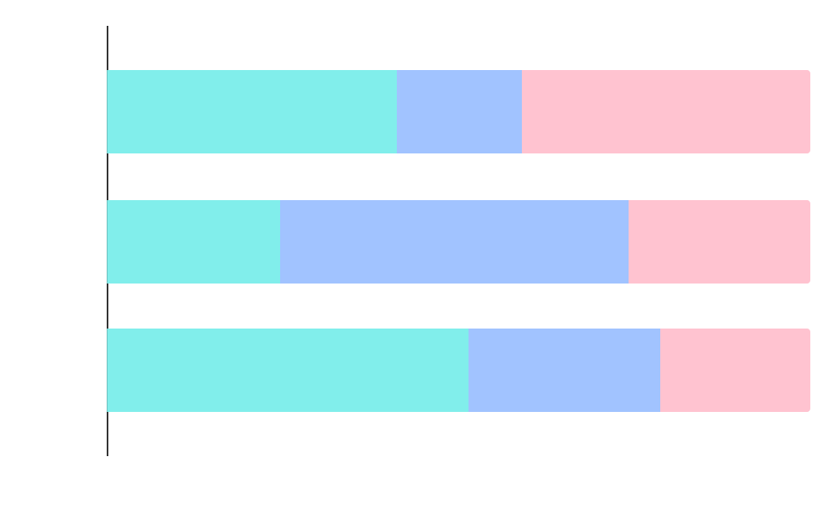
Predicted results
Visit
43%
Venus is the second planet from the Sun
Orders
17%
Despite being red, Mars is a cold place
Increase
40%
Jupiter is the biggest planet of them all
Follow the link in the graph to modify its data and then paste the new one here. For more info, click here

Slide 26
This is a map
Venus
Mars
Venus has very high temperatures
Despite being red, Mars is actually cold
Saturn
Neptune
It’s composed of hydrogen and helium
It’s the farthest planet from the Sun

Slide 27
Project timeline
Mercury
Mars
It’s the closest planet to the Sun
Mars is actually a very cold place
2019
2020
2021
Saturn
It’s composed of hydrogen and helium

Slide 28
Project table
Project | Costs | Balances | Price | Plan | Budget
Project 1 | 0.06 | 0.38 | 0.38 | 1A | 1.46
Project 2 | 0.11 | 0.53 | 0.38 | 2D | 9.4
Project 3 | 95.2 | 9.4 | 1.16 | 3B | 0.16

Slide 29
Projects per week
01
Visual design
Venus is the second planet from the Sun
HTML
02
Mars is actually a very cold place
03
CSS
Neptune is the farthest planet from the Sun
Java Script
04
Saturn is a gas giant and has several rings
05
UX
Saturn is made of hydrogen and helium

Slide 30
Business web steps
Website
Programming
Design
Step 1
Step 2
Step 3
Mercury is the closest planet to the Sun and the smallest one in the Solar System
Jupiter is a gas giant and the biggest planet in the entire Solar System
Venus has a beautiful name and is the second planet from the Sun

Slide 31
User profile
15%
10%
25%
15%
28%
78%
64%
25%
32%
22 - 30 years
25 - 40 years
50%

Slide 32
Monthly calendar
Meeting
Preview
Mon | Tue | Wed | Thu | Fri | Sat | Sun
 |  | 1 | 2 | 3 | 4 | 5
6 | 7 | 8 | 9 | 10 | 11 | 12
13 | 14 | 15 | 16 | 17 | 18 | 19
20 | 21 | 22 | 23 | 24 | 25 | 26
27 | 28 | 29 | 30
Neptune is very far from the Sun
Mars is actually a very cold place
Presentation
Deadline
Saturn is made of hydrogen and helium
The Earth is the planet where we live

Slide 33
User comments
”Neptune is the farthest planet from the Sun“
”The Earth is the planet where we all live“
”Despite being red, Mars is very cold“

Slide 34
Awesome words

Slide 35
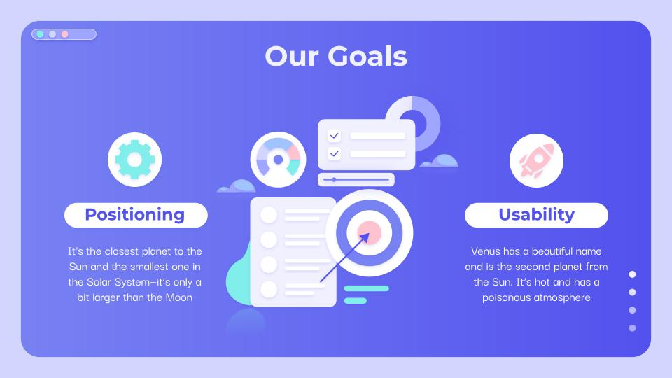
Tablet App
You can replace the image on the screen with your own work. Just right-click on it and select “Replace image”

Slide 36
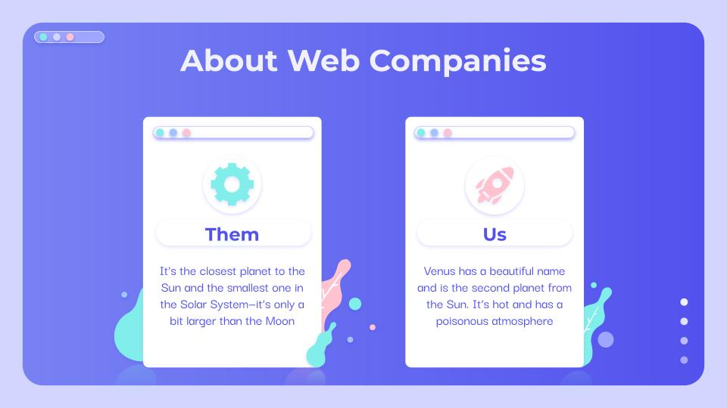
Desktop software
You can replace the image on the screen with your own work. Just right-click on it and select “Replace image”

Slide 37
Our team
Timmy Jimmy
Jenna Doe
Susan Bones
Here you can talk a bit about this person
Here you can talk a bit about this person
Here you can talk a bit about this person

Slide 38
Thanks!
Do you have any questions?
youremail@freepik.com
+91 620 421 838
yourcompany.com
Please keep this slide for attribution

Slide 39
Web-Design Icon Pack

Slide 40
Alternative Resources
Here’s an assortment of alternatives resources within the same style of this template

Slide 41
Resources
Did you like the resources on this template? Get them for free at our other websites:
Photos
Businesspeople at office meeting
Business people meeting at office working
Icons
Icon Pack: Web Design
Vectors
Digital screens and plants 3d concepts landing page
Mobile phone interface 3d concepts landing page
Online purchases from home 3d concepts landing page
Social online interaction 3d concepts landing page
Monochrome violet 3d concepts landing page
Social media marketing landing page template
Strategy marketing landing page template
Connecting teams concept for landing page

Slide 42
Instructions for use
In order to use this template, you must credit Slidesgo by keeping the Thanks slide.
You are allowed to:
- Modify this template.
- Use it for both personal and commercial projects.
You are not allowed to:
- Sublicense, sell or rent any of Slidesgo Content (or a modified version of Slidesgo Content).
- Distribute Slidesgo Content unless it has been expressly authorized by Slidesgo.
- Include Slidesgo Content in an online or offline database or file.
- Offer Slidesgo templates (or modified versions of Slidesgo templates) for download.
- Acquire the copyright of Slidesgo Content.
For more information about editing slides, please read our FAQs or visit Slidesgo School:
https://slidesgo.com/faqs and https://slidesgo.com/slidesgo-school

Slide 43
Fonts & colors used
This presentation has been made using the following fonts:
Montserrat
(https://fonts.google.com/specimen/Montserrat)
Darker Grotesque
(https://fonts.google.com/specimen/Darker+Grotesque)
#5352ee
#7882f3
#9ea6ff
#d2d6ff
#a1c3ff
#ffc3d0
#81eeeb
#3ae4df
#f1f0ff
#ffffffff

Slide 44





Storyset
Create your Story with our illustrated concepts. Choose the style you like the most, edit its colors, pick the background and layers you want to show and bring them to life with the animator panel! It will boost your presentation. Check out How it Works.
Pana
Amico
Bro
Rafiki
Cuate

Slide 45
Use our editable graphic resources...
You can easily resize these resources without losing quality. To change the color, just ungroup the resource and click on the object you want to change. Then, click on the paint bucket and select the color you want. Group the resource again when you’re done. You can also look for more infographics on Slidesgo.

Slide 48
JANUARY
FEBRUARY
MARCH
APRIL
MAY
JUNE
PHASE 1
Task 1
Task 2
PHASE 2
Task 1
Task 2
JANUARY
FEBRUARY
MARCH
APRIL
PHASE 1
Task 1
Task 2

Slide 51


